Slide 1
Youth Mission
Food Sensory Evaluation

Slide 2
01
Definition
02
Multidisciplinity
03
Test methods
Hedonic test
Descriptive test
Triangle test

Slide 3
Definition
Sensory food science is:
A discipline dealing with human sensory perceptions of and affective responses to foods, beverages and their components.
It is multidisciplinary by its nature, deriving research questions from food science and applying behavioural research methods to solve these questions.
A scientific discipline used to evoke, measure, analyze, and interpret reactions to those characteristics of food as they are perceived by the senses of sight, smell, touch, taste, and hearing.

Slide 4
Multidisciplinarity
Food Science
Knowledge in statistics
Sensory scientist
Behavioral research and experimental psychology (human responses)
Knowledge in data interpretation

Slide 5
Test methods
1. Affective test method (hedonic test) – likeness, preference
2. Descriptive test method – focuses on specific characteristics of a product (e.g., sweetness, bitterness, creaminess, etc.)
3. Discrimination test method (e.g., triangle test) – are two products different in any way?

Slide 6
Tasting (hedonic test)
5-point Likert Scale of preference
Dislike a lot
Dislike a little
Neither like nor dislike
Like a little
Like a lot
______________________________________________________
1
2
3
4
5

Slide 7
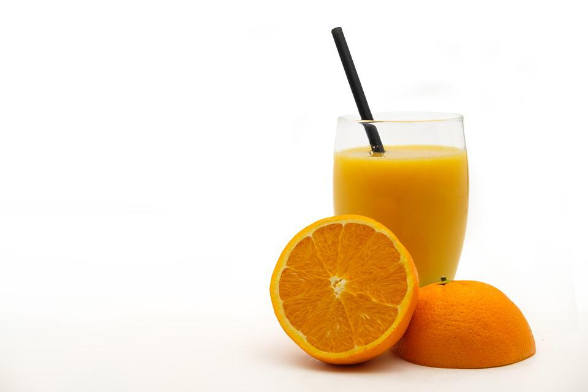
Tasting (descriptive test)
Describing a food product (orange juice)
Special vocabulary used to describe the product. Some examples for orange juice are:
Odour
Fruity
Cooked
Sweet
Floral
Flavour
Sweet
Sour
Burned
Watery
Texture
Smooth
Dense
Astringent
Watery
Aftertaste
Bitter
Sweet
Spicy
Citric
Source (photo): Pixabay

Slide 8
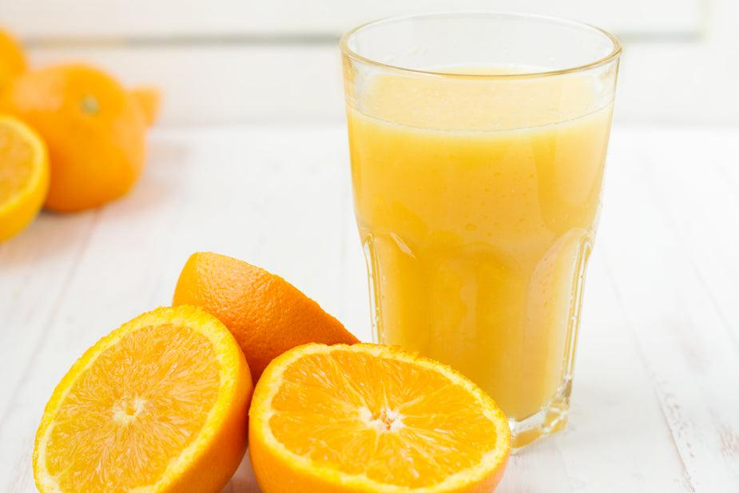
Tasting (Triangle test)
A
1. Concentrate
2. Taste
3. Answer the following:
B
A
Which one of the three orange juices is the different one?
Source (photo): Burst

Slide 9


Q&A
Follow us on

Slide 10
Thank you!

